Slide 1


Generating Probabilistic Machine-Learned Forecasts for Severe Weather and Excessive Rainfall Prediction
Aaron J. Hill and Russ S. Schumacher
Colorado State University
NWS Central Region
Wednesday 19 July 2022

Slide 2
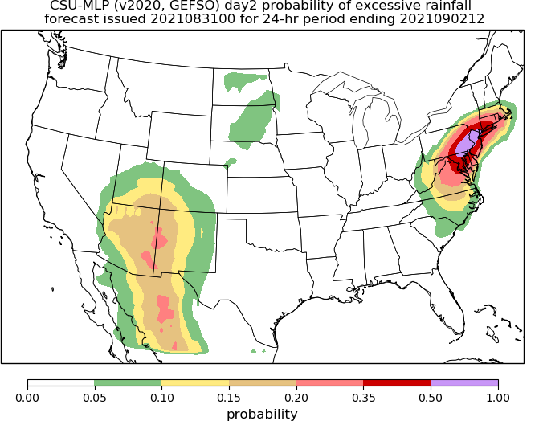
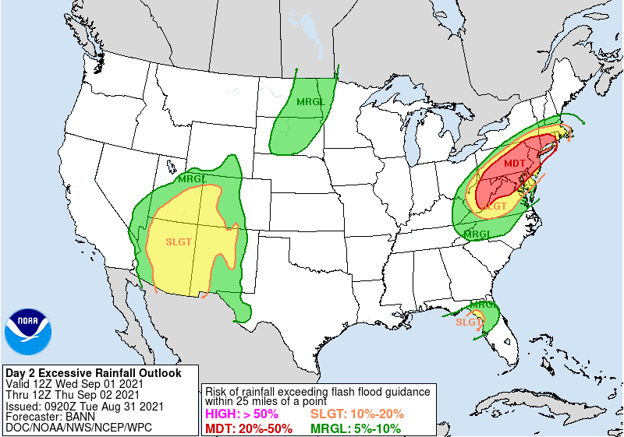
Motivation
Machine learning (ML) is becoming more prevalent in weather forecasting as an alternative method to postprocess the numerous and vast datasets that dynamical models produce
As one example, ML systems are now emulating Storm Prediction Center and Weather Prediction Center outlooks
HREF (Loken et al. 2020; NSSL)
HRRR (Sobash et al. 2020; NCAR)
GEFS (CSU-MLP model; Hill et al. 2020, Schumacher et al. 2021)
FIRST GUESS
WPC ERO
Notes:
ML is becoming more prevalent in weather forecasting as an alternative means to leverage the numerous and vast datasets that dynamical models produce
As one example, there are now (that we know of) three separate ML systems that forecast severe weather by emulating Storm Prediction Center outlooks
These are based on the HREF, HRRR, and GEFS (loken, Sobash, Hill)

Slide 3
Why Machine Learning (ML)?
Do it better
e.g. Models do not specifically forecast convection hazards, use ML to make explicit forecasts
Do it faster
e.g. Radiation code in models is very slow (but we know the right answer) - use ML methods to speed things up
Do something new
e.g. Go looking for non-linear relationships you didn’t know were there
Credit: CSU Machine Learning Workshop

Slide 4
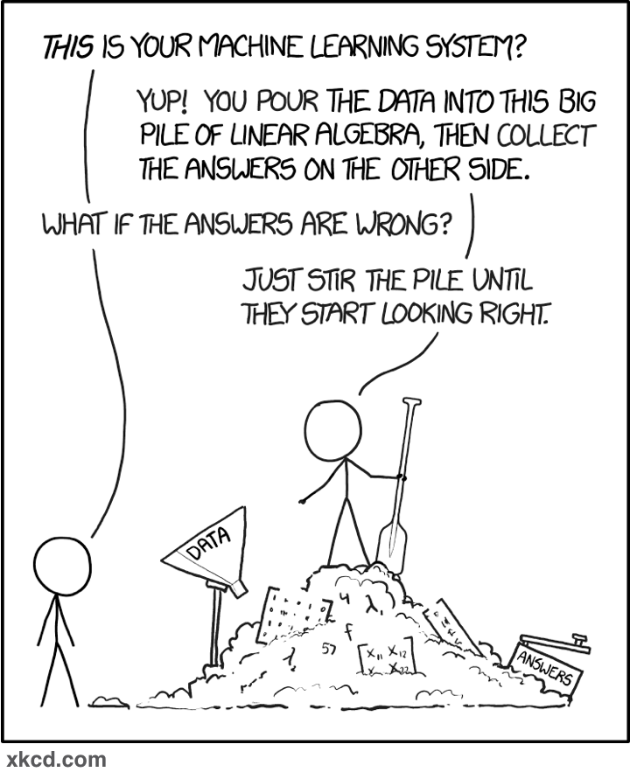
The ML “Black Box”
ML is not a futuristic, black-box idea anymore,
specifically within geophysical applications…
data
prediction
The box is configurable and interpretable
MOS is a ”primitive” example: Predict Y from records of X(s)
Recommended reading: McGovern et al. (2019), “Making the Black Box More Transparent: Understanding the Physical Implications of Machine Learning”, BAMS

Slide 5
Application to convection hazards
Our focus to this point has been on excessive rainfall and severe weather (tornado, large hail, damaging winds)
NWP models don’t explicitly predict any of these
For excessive rainfall, we have QPF, but not much about whether it’s “excessive” or likely to cause flash flooding
For severe hazards, need to use proxies like updraft helicity (e.g., Sobash et al. 2016)
But we do now have the observations we need (mostly) and a long record of “reforecasts” that we can use
Prime opportunity to do something better

Slide 6
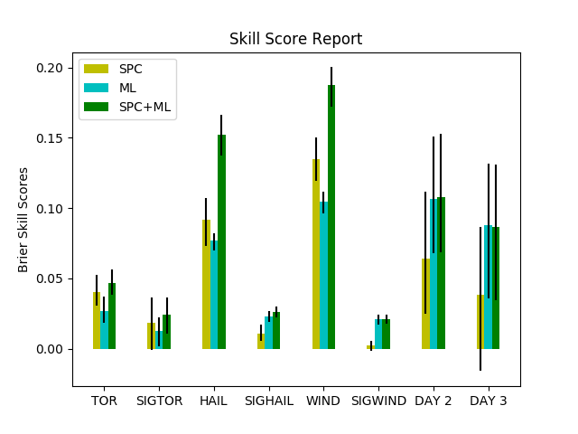
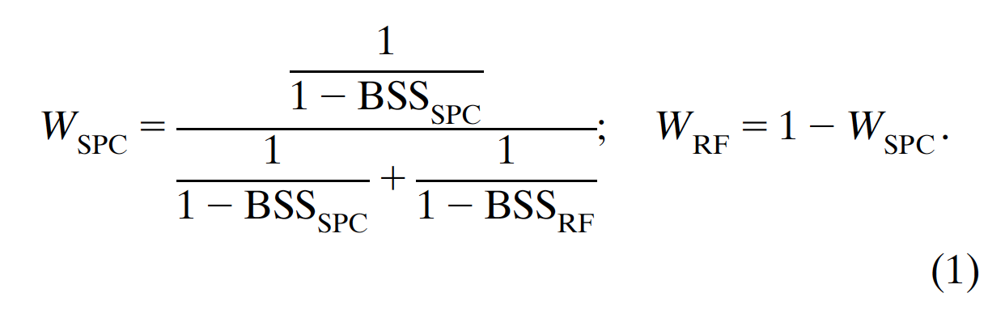
Motivation
Day 1
Day 2
Day 3
One of the reasons these types of systems are being pursued is the operational benefit that might be incurred → “first guess” fields
A combination of SPC and random forest (RF)-based outlooks (i.e., blend) can outperform either individual forecast/outlook (Hill et al. 2020)
The incorporation of ML-based guidance into the human forecast improved the guidance
Benefit extended beyond day 1
ML forecasts (and the blends) were more skillful at days 2 and 3
Blend weights:
Hill et al. (2020)
Notes:
One of the reasons these types of systems are being pursued is the operational benefit that might be incurred
In Hill et al. 2020, SPC outlooks and RF-based forecasts of severe weather (individual hazards as well as aggregate hazards) were evaluated against one another.
One important outcome of that work was that a combination of SPC and RF outlooks (i.e., blend) often outperformed either individual component
In other words, the incorporation (in our example a statistical manner) of ML-based guidance was improving upon the human forecasts
One additional outcome, that motivates the rest of this presentation, is the benefit was that was seen beyond day 1
ML forecasts (and the blends) were improved at days 2 and 3 over SPC outlooks

Slide 7
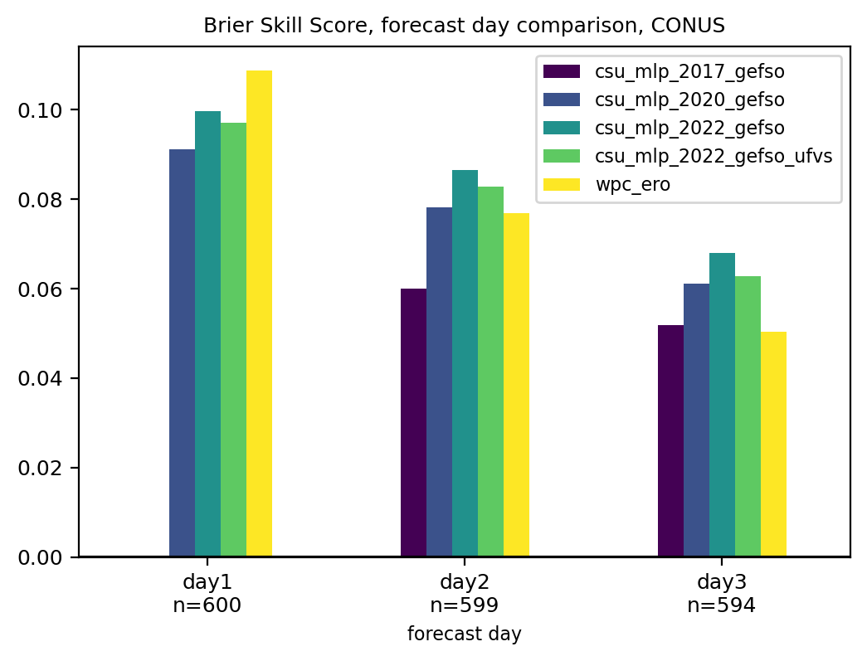
Motivation
WPC ERO is best on day 1, but CSU-MLP is better on days 2-3
Iterative improvements through evaluation at HMT FFaIR
5+ years of collaboration with WPC (and recently with SPC) have yielded operational ML prediction systems regularly used by forecasters at days 1-3
Notes:
One of the reasons these types of systems are being pursued is the operational benefit that might be incurred
In Hill et al. 2020, SPC outlooks and RF-based forecasts of severe weather (individual hazards as well as aggregate hazards) were evaluated against one another.
One important outcome of that work was that a combination of SPC and RF outlooks (i.e., blend) often outperformed either individual component
In other words, the incorporation (in our example a statistical manner) of ML-based guidance was improving upon the human forecasts
One additional outcome, that motivates the rest of this presentation, is the benefit was that was seen beyond day 1
ML forecasts (and the blends) were improved at days 2 and 3 over SPC outlooks

Slide 8
Medium-range Products
Convection-allowing models (CAMs) primarily limited to day 3 or earlier
Deterministic global model solutions beyond day 3 (GFS, ECMWF, etc.)
Global ensembles (GEFS, ECMWF Ensemble, etc.)
Beyond the SREF (e.g., total severe), there is limited postprocessing at extended ranges
Direct use of ensemble mean doesn’t provide a lot of confidence for convection hazards
Goal: Extend the CSU-MLP RF-based guidance products out to days 4-8 and redevelop day 1-3 models with new FV3-GEFS

Slide 9
What are Random Forests?

Slide 10
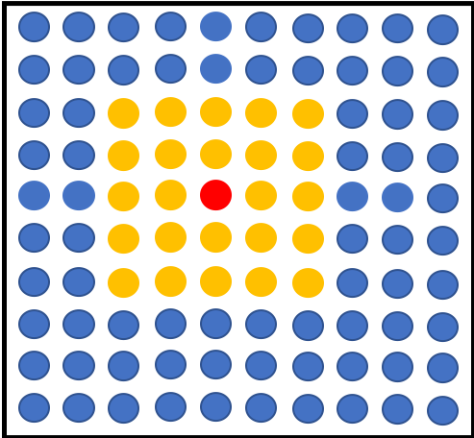
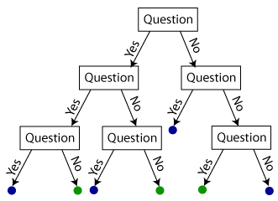
Forecast point
Random Forests
Temperature at (-2, -1) > 20 C?
A set of decision trees that contain a series of yes/no questions based on input predictors that allow traversal of the tree
Relative frequency of events across the forest is the forecast probability
Python Scikit-learn package controls how the decision trees are developed during model training, i.e., what predictor information is used at each branch node to discriminate observed hazards
…..
CAPE at (1, -2) > 500 J/kg?
Probability of severe hail
50%

Slide 11
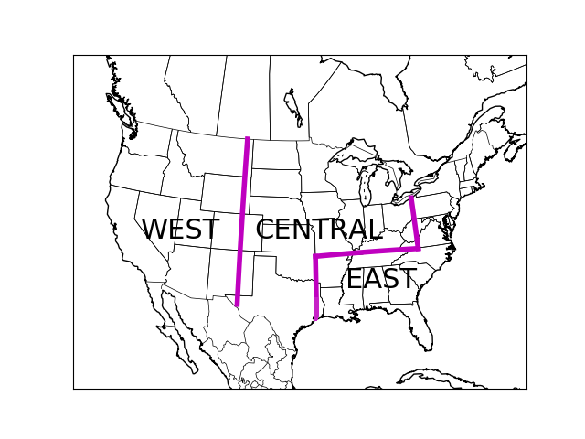
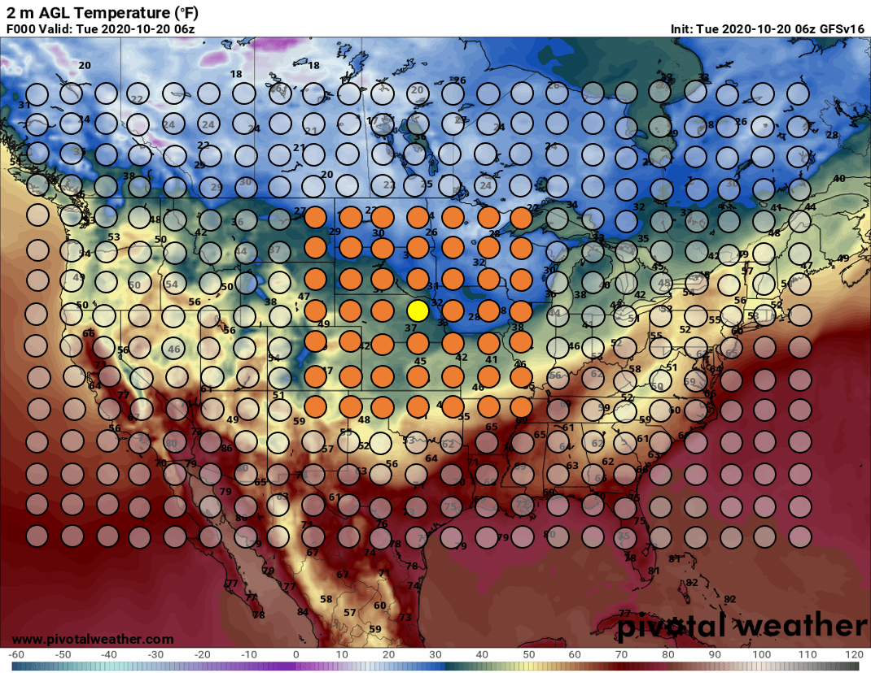
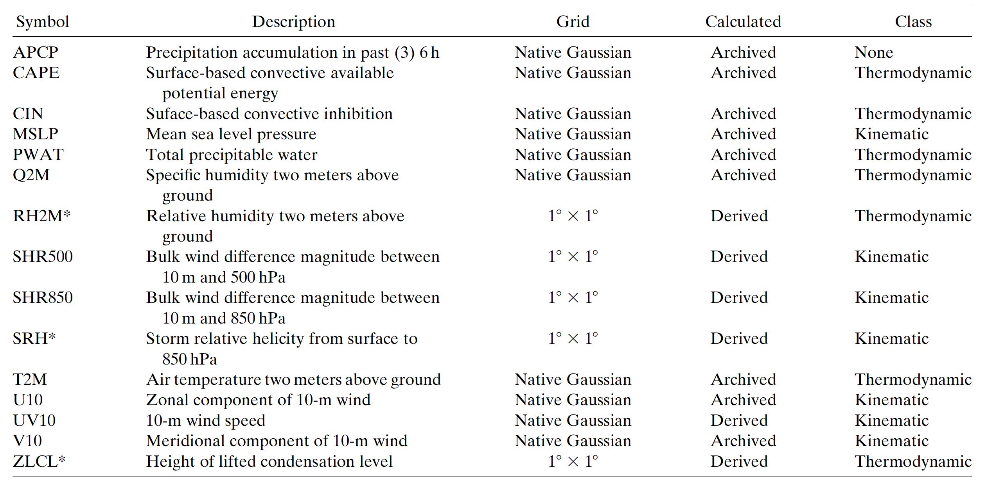
RF Model Setup
Observations of the convection hazard of choice are gridded for training purposes (e.g., local storm reports, flash flood guidance exceedance)
Inputs: FV3-GEFS/Reforecast ensemble median
Daily 00Z initializations with 5 members
Use years of initilizations (e.g., 2003-2012) and corresponding gridded observations
3-hourly temporal frequency over the 24-hour forecast periods (i.e., 1200-1200 UTC)
Each observation is paired with meteorological data from the GEFS/R in space and time
Captures any spatiotemporal model biases
Combination of raw fields and derived quantities (e.g., SRH)
Train RFs regionally; they use the same set of meteorological. variables as predictors
This methodology is mostly hazard agnostic
Models are capable of forecasting hazards in 24hr windows, mimicking the operational center products

Slide 12
Training Procedure
April 2003 – April 2012
Variables
APCP
CAPE
CIN
MSLP
PWAT
Q2
T2M
0-500 Shear
0-850 Shear
U10
V10
UV10
Days of Training
FV3-GEFS/R gridded dataset
…………
Gridded local storm report
Temporal Frequency
(e.g., 3 hrly)
Real-time model output
MODEL
Spatial frequency (5 grid points)

Slide 13
CSU-MLP Severe Weather Forecast Performance
Excessive Rainfall Prediction System
Schumacher, R. S., A. J. Hill, M. Klein, J. Nelson, M. Erickson, S. M. Trojniak, and G. R. Herman, 2021: From random forests to flood forecasts: A research to operations success story. Bulletin of the American Meteorological Society, 102, E1742-E1755, doi:10.1175/BAMS-D-20-0186.1.

Slide 14
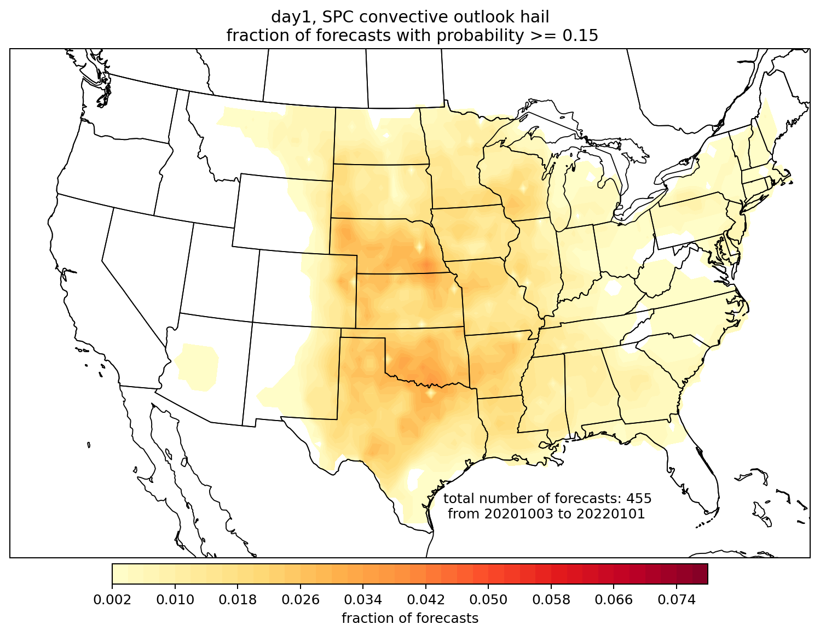
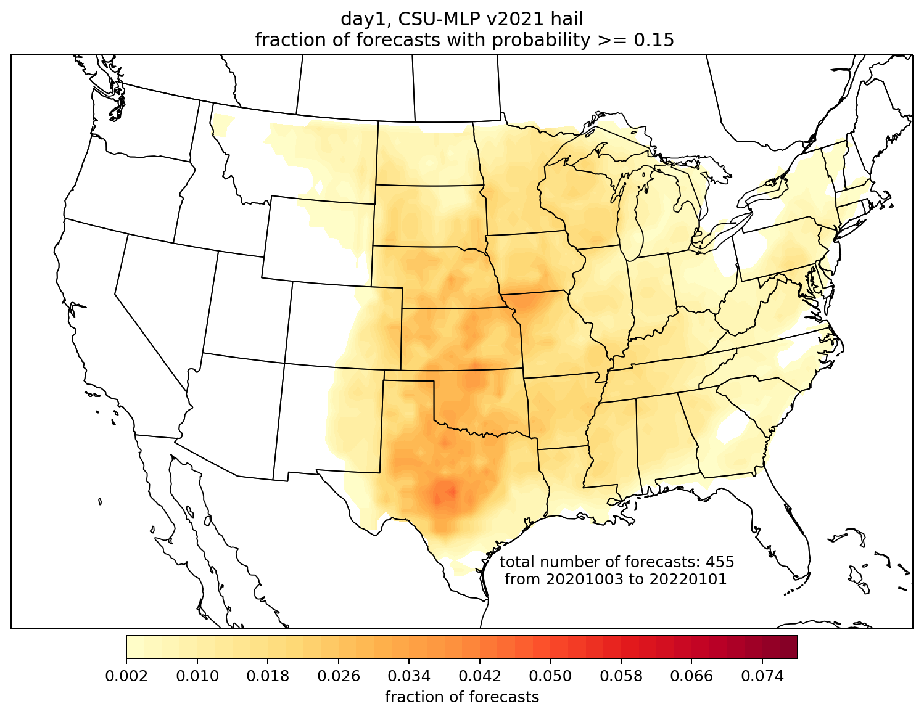
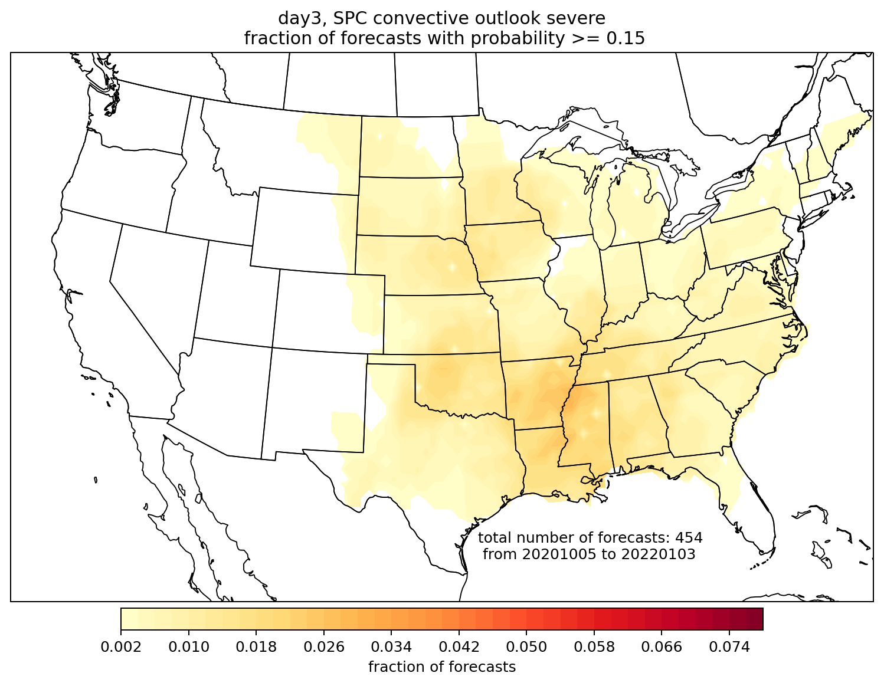
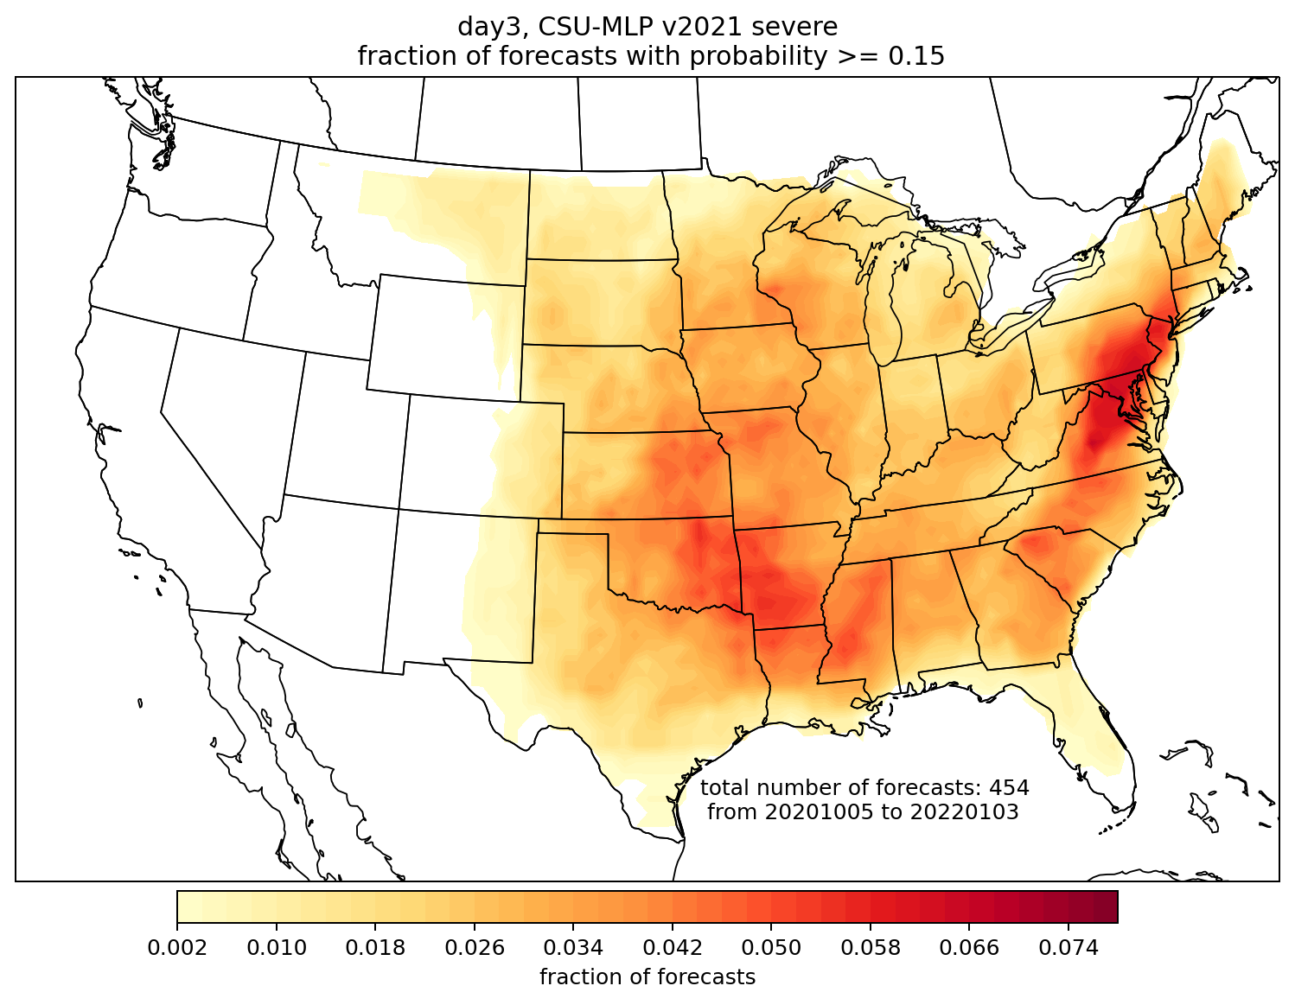
CSU-MLP forecast probabilities are issued at similar frequency to SPC on day 1; much more frequently on day 3
Day 1 hail, 15%
SPC
CSU-MLP
Day 3,
all severe, 15%
SPC
CSU-MLP

Slide 15
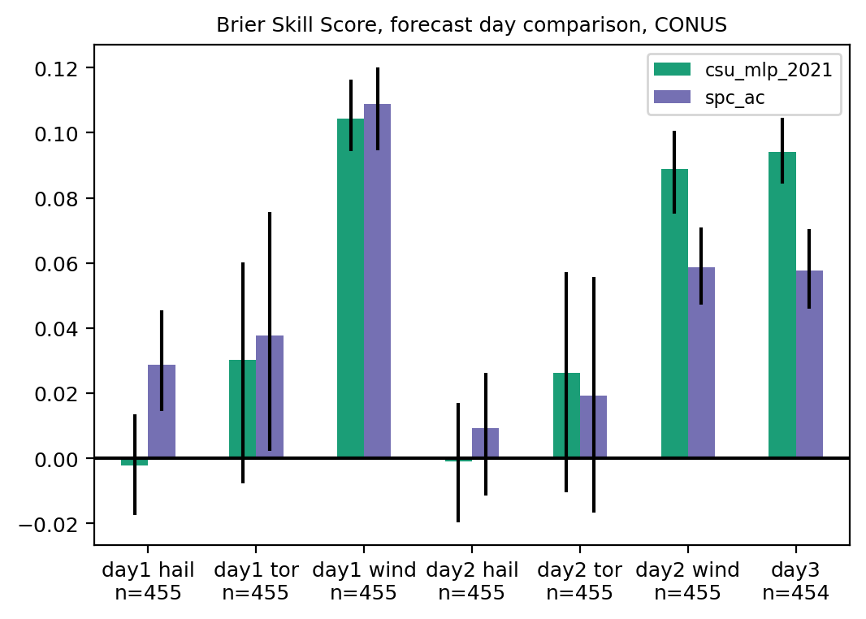
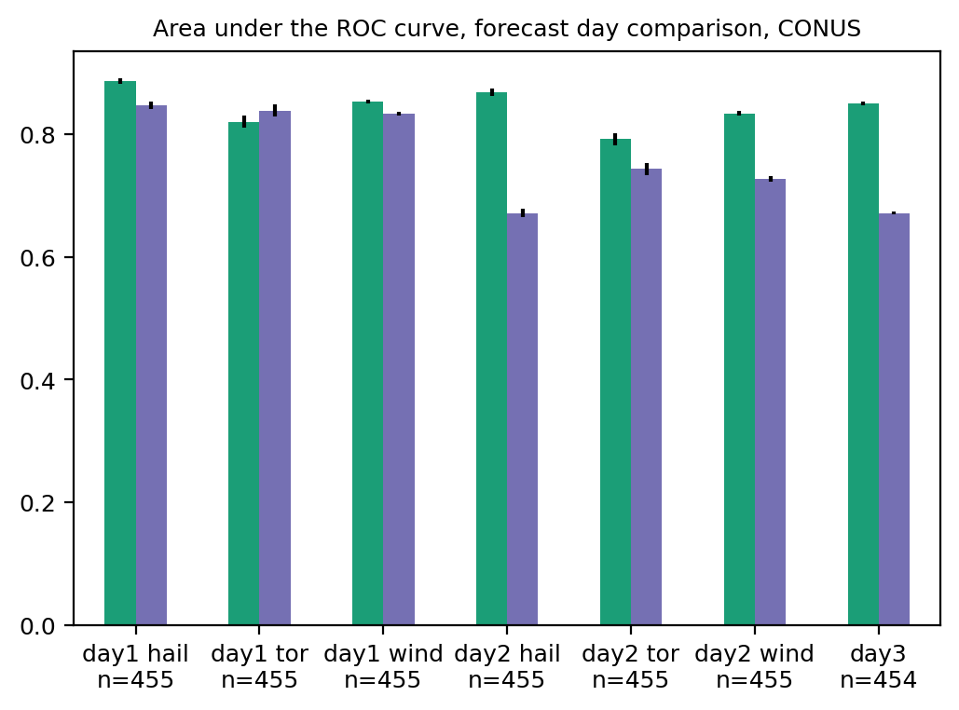
Brier skill score and ROC area, by day and hazard
Tough to beat SPC’s expertise on day 1: they show higher BSS for all hazards, though ROC area is more comparable
Both SPC and CSU-MLP were most skillful for wind, least for hail
CSU-MLP was more skillful for day 2 wind and day 3; high ROC areas suggest potential for further improvement with better calibration

Slide 16
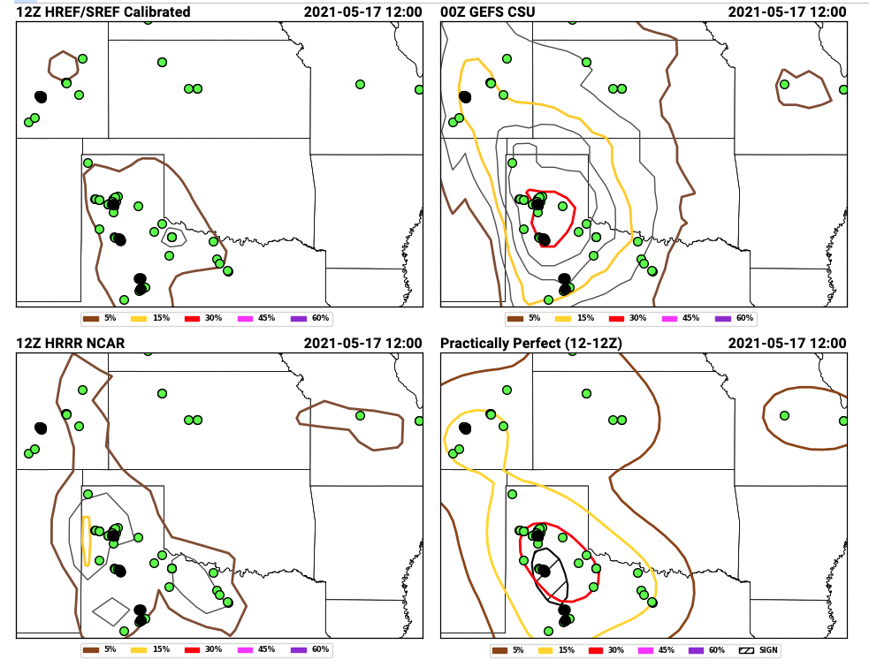
These forecasts were demonstrated and evaluated during the Hazardous Weather Testbed Spring Forecasting Experiment
Day-2 hail forecasts issued 15 May 2021, valid 16-17 May 2021
Day-2 hail forecasts issued 15 May 2021, valid 16-17 May 2021
https://hwt.nssl.noaa.gov/sfe_viewer/2021/outlook_verification/

Slide 17
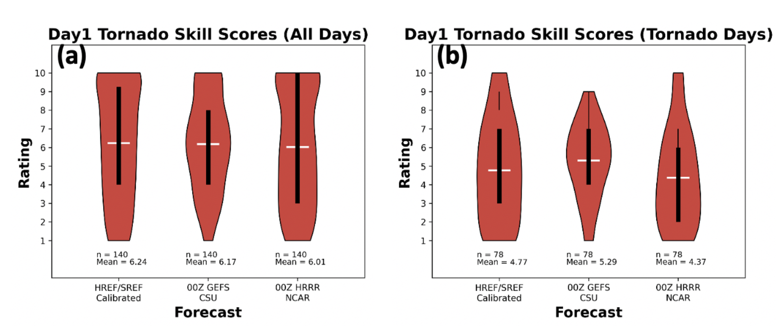
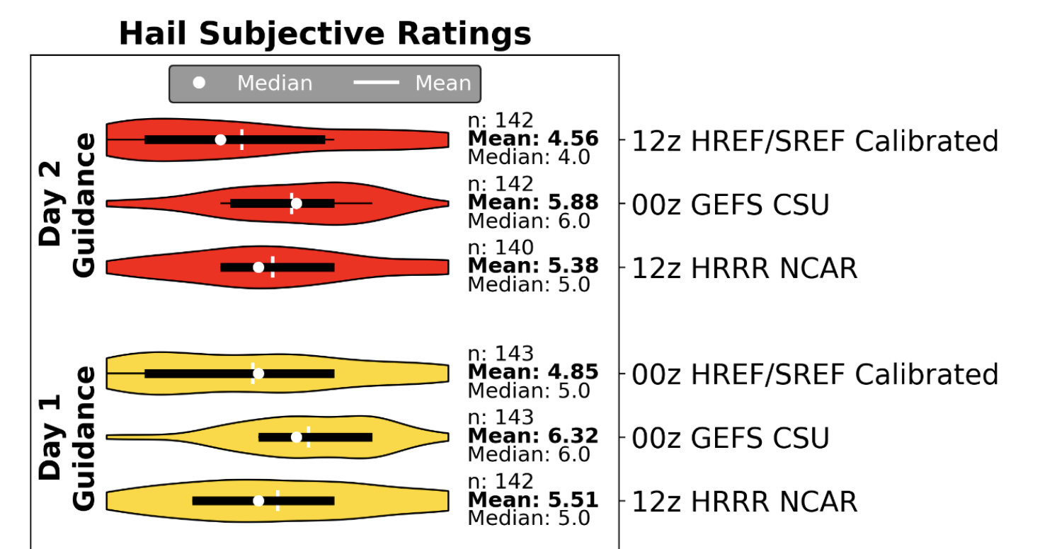
Subjective evaluations by participants (1-10 scale)
“For the set of tornadic days [for day 1 guidance], GEFS CSU performs the best with a mean skill score of 5.39 as compared to the other two methods, which have mean score values less than 4.8.”
[For day 1 hail guidance], “GEFS CSU received the greatest mean participant rating (6.32), followed by HRRR NCAR (5.51) and HREF/SREF (4.85; yellow violins in Fig. 6).”
https://hwt.nssl.noaa.gov/sfe/2021/docs/HWT_SFE_2021_Prelim_Findings_FINAL.pdf

Slide 18
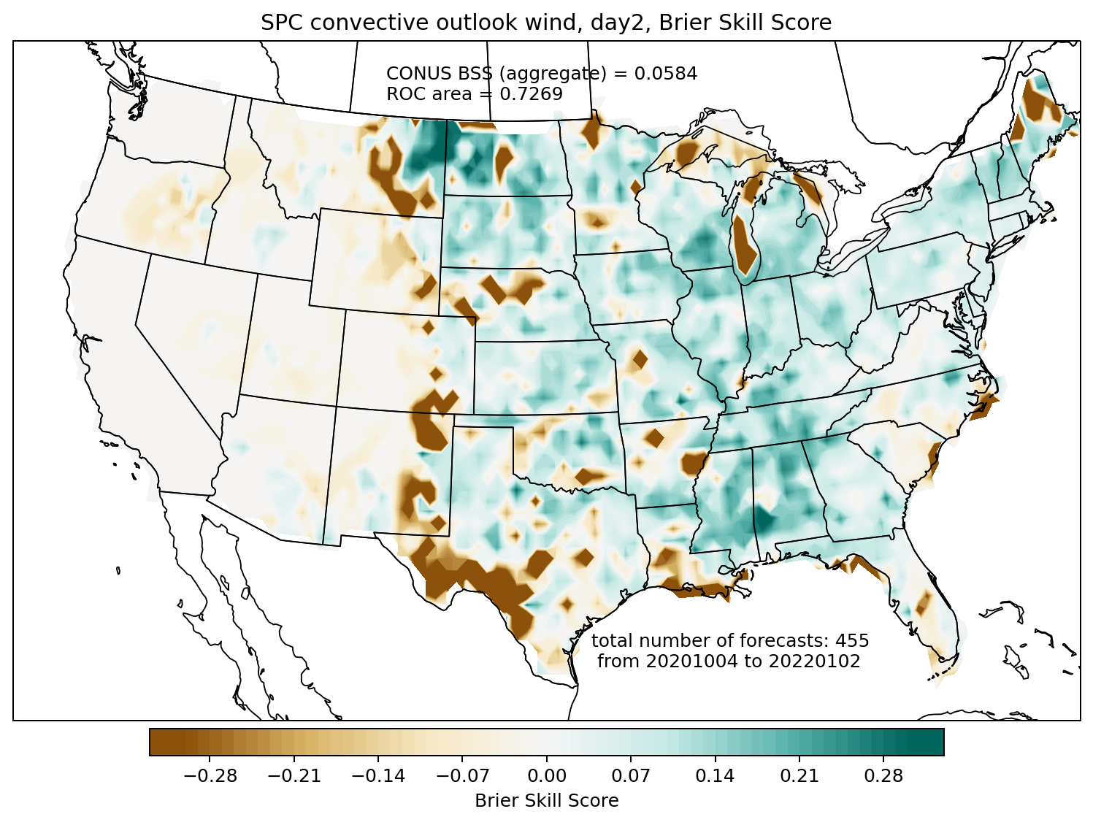
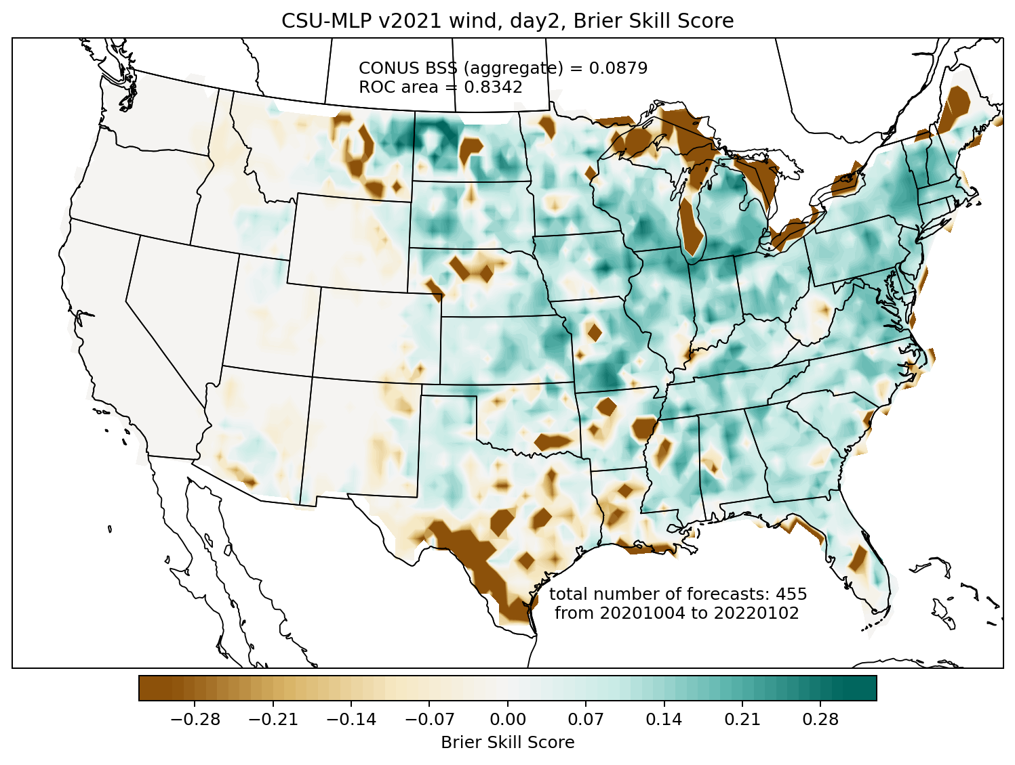
Brier skill score comparison: day 2 wind
SPC convective outlook
CSU-MLP
CSU-MLP showed higher skill, especially in the Great Lakes and northeast

Slide 19
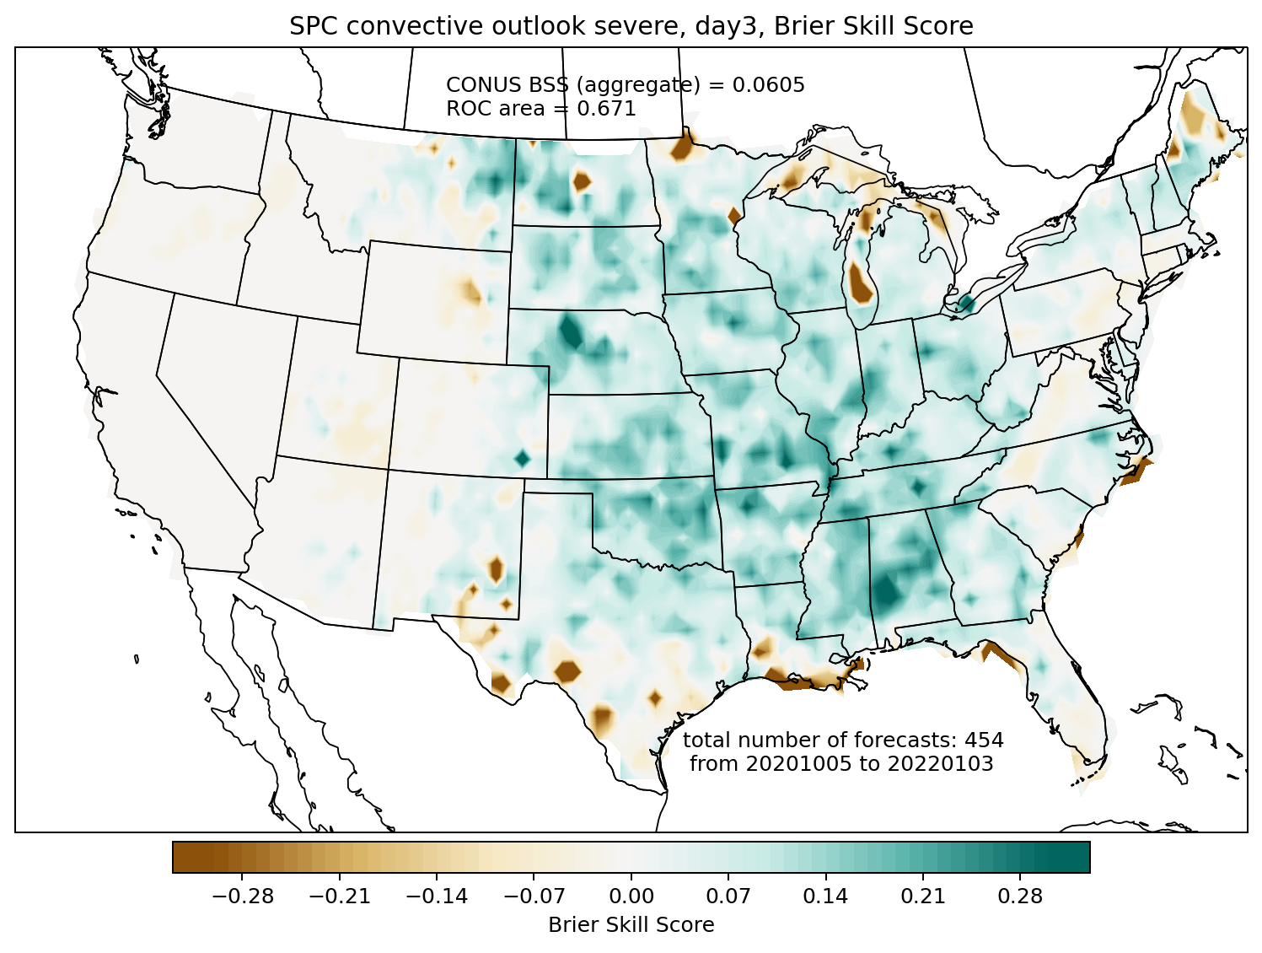
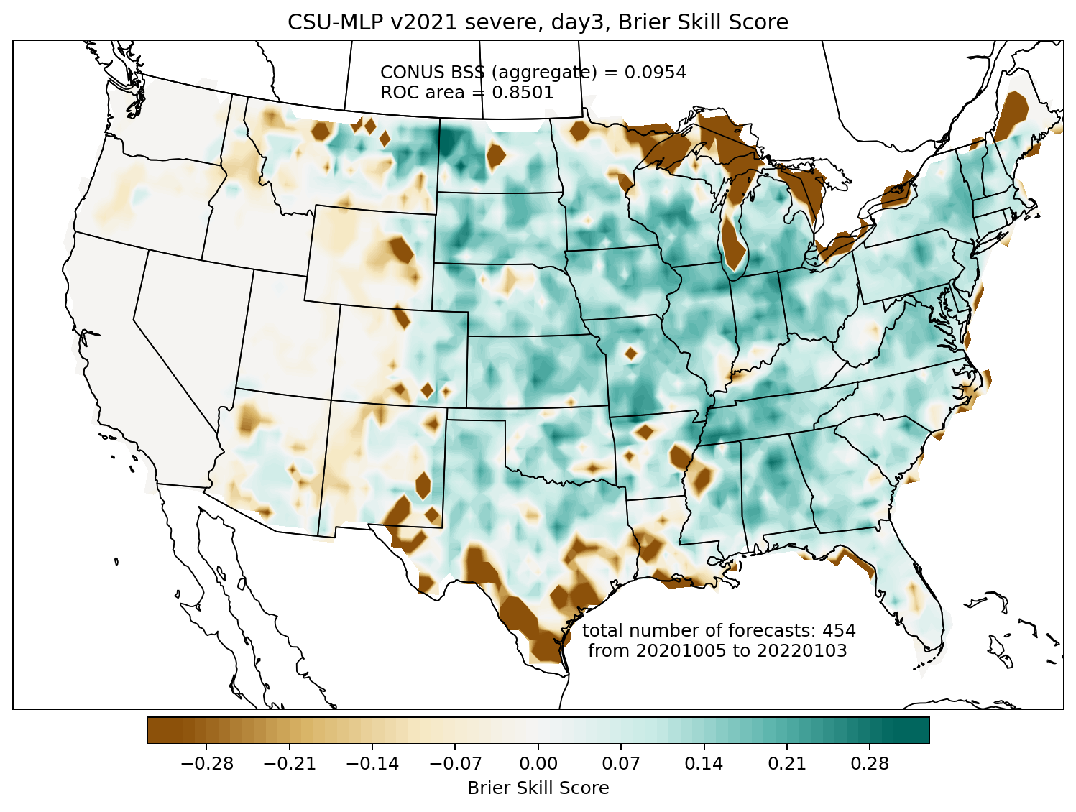
Brier skill score comparison: day 3 severe
SPC convective outlook
CSU-MLP
CSU-MLP significantly more skillful on day 3: it takes a lot more swings, and hits some big home runs, at the expense of also some big misses

Slide 20
Medium Range Forecast Performance

Slide 21
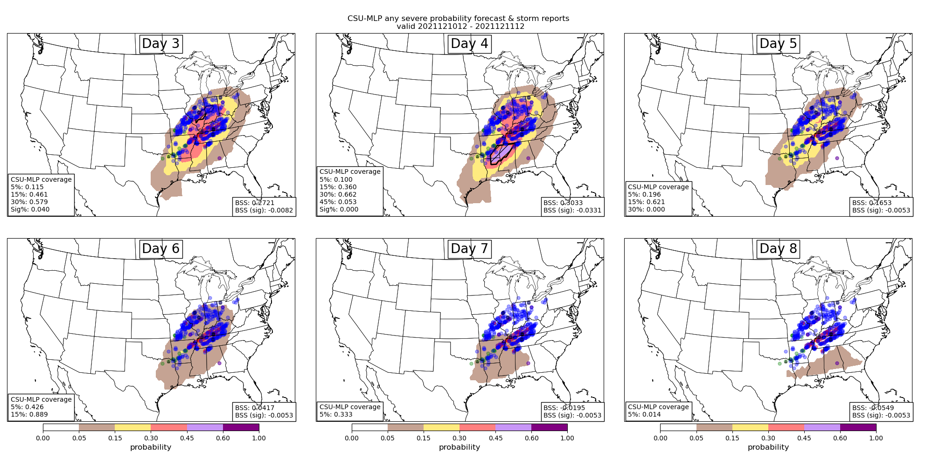
Medium-Range Example Forecasts
Valid 1200 – 1200 UTC 12/10/21 – 12/11/21
Hill et al. 2022, in prep

Slide 22
Frequency of occurrence day 4 forecasts
2 October 2020 – 1 April 2022
FV3-GEFS became operational October 2020
While trained on reforecast dataset, realtime forecasts made with operational GEFS
Hill et al. 2022, in prep

Slide 23
Seasonal Frequency of SPC and CSU-MLP
Hill et al. 2022, in prep

Slide 24
Forecast Skill
Uses 5, 15, and 30 contours
Day 3: 0.09
Forecast skill extends (reasonably) out to day 6 for the CSU system
Forecast resolution (ROC area) naturally decreases with decreasing lead time; significant portion of resolution (and skill) comes from low-probability contours
Hill et al. 2022, in prep

Slide 25
Spatial Forecast Skill
SPC forecasters are conservative, CSU-MLP is not
Slightly positive skill across most of CONUS east of Rockies
Negative RF skill where no reports exist in the verification period

Slide 26
Spatial Forecast Skill
SPC forecasters are conservative, CSU-MLP is not
Slightly positive skill across most of CONUS east of Rockies
Negative RF skill where fewer reports exist in the verification period → overforecasting?

Slide 27
Spatial Forecast Skill
Uses 5, 15, and 30 contours
Lower probability contours improve skill substantially CONUS wide
Lower probabilities are well-calibrated, are a better indicator of severe weather potential in the medium range

Slide 28
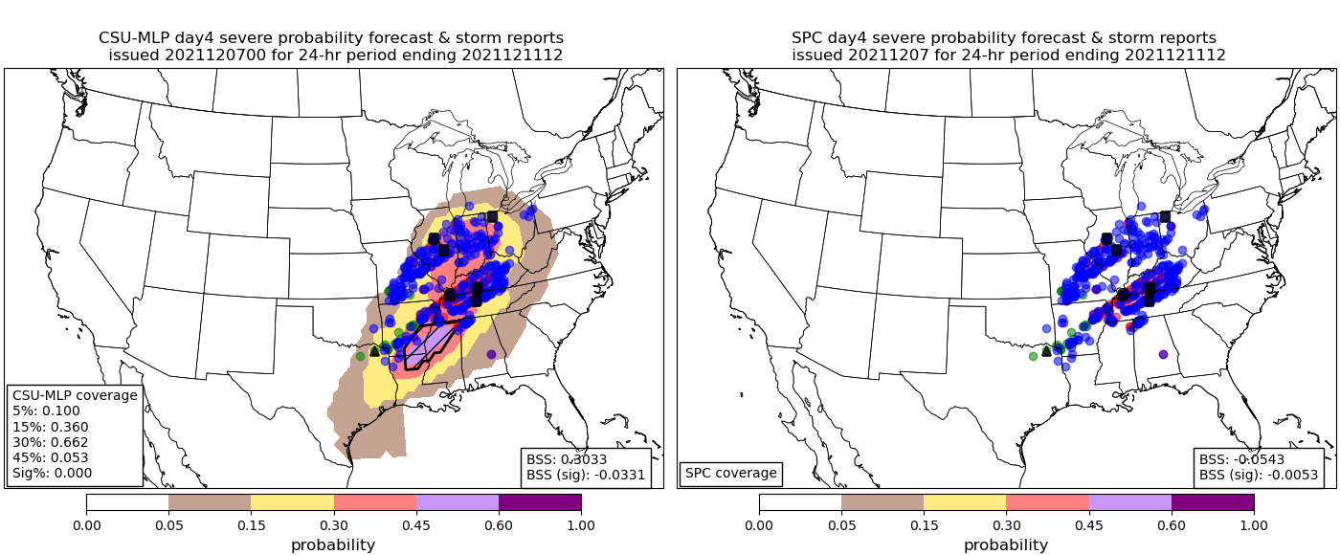
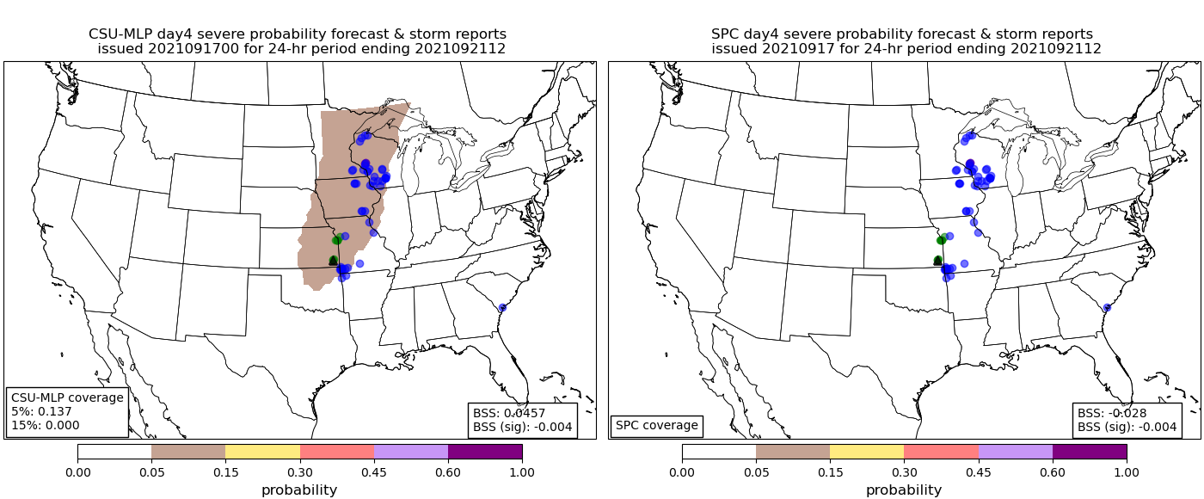
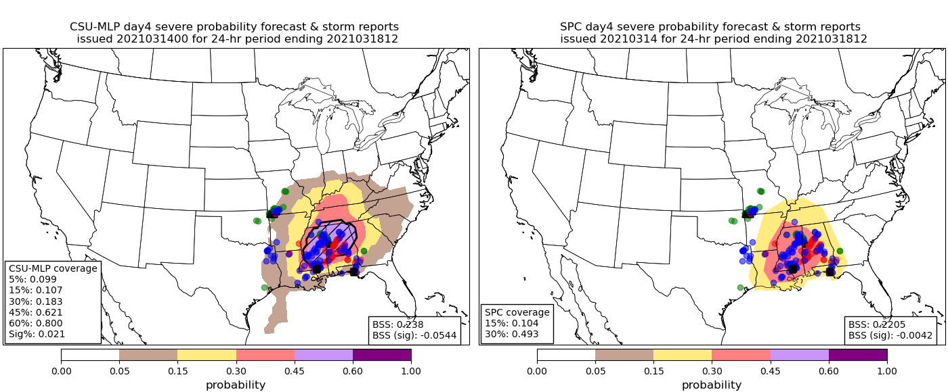
Still Learning…
Day 4
BSS: 0.303
Day 4
BSS: -0.054
BSS: 0.046
BSS: -0.028
Day 4
CSU-MLP RFs seem to benefit from frequently “swinging” at low-probability events (issuing low-probability forecasts)
But busts still occur…the “why” is a critical research question → interpretability metrics
BSS: 0.238
BSS: 0.221

Slide 29
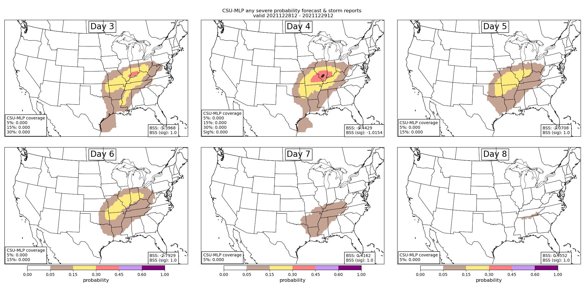
Still Learning…

Slide 30
Interpretability and Explainability
Understanding our forecasts

Slide 31
Interpretability/Explainability
Known or postulated relationships between meteorological variables and severe weather are learned by the RFs
CAPE, CIN, 0-500hPa Shear, MSLP
Why is CIN more important than CAPE at day 8? Why does 2m specific humidity (Q2) replace CIN as most important predictor in one region but not another?

Slide 32
Interpretability/Explainability
Forecast Period
Train RFs with prior-day meteorological variables → are local changes near observed events important for the RFs to learn? These models are as skillful as their counterparts (not shown, Hill et al. 2022) and training time is significantly less
Ramp ups in thermodynamic variables are clear in regional models; kinematic information perhaps slightly more important over the time period defining the observed events

Slide 33
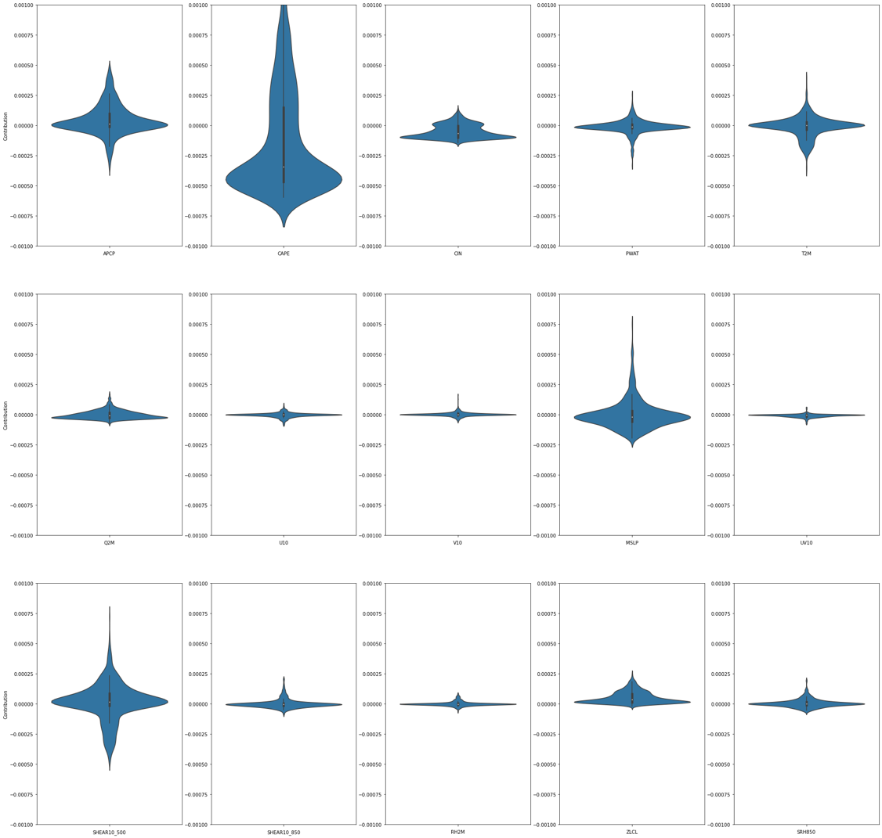
Interpretability/Explainability
CAPE
OK, the RFs learned important relationships in training…
What do they use on a day-to-day basis to make forecasts?
Probability = contribution₁ + contribution₂ + … + contribution_{n} + bias
Sum contribution of each meteorological variable/predictor across all forecasts
Day 1 hail forecast contributions
CIN
APCP
MSLP
500 Shear
Credit: Hanna McDaniel, CSU REU Student

Slide 34
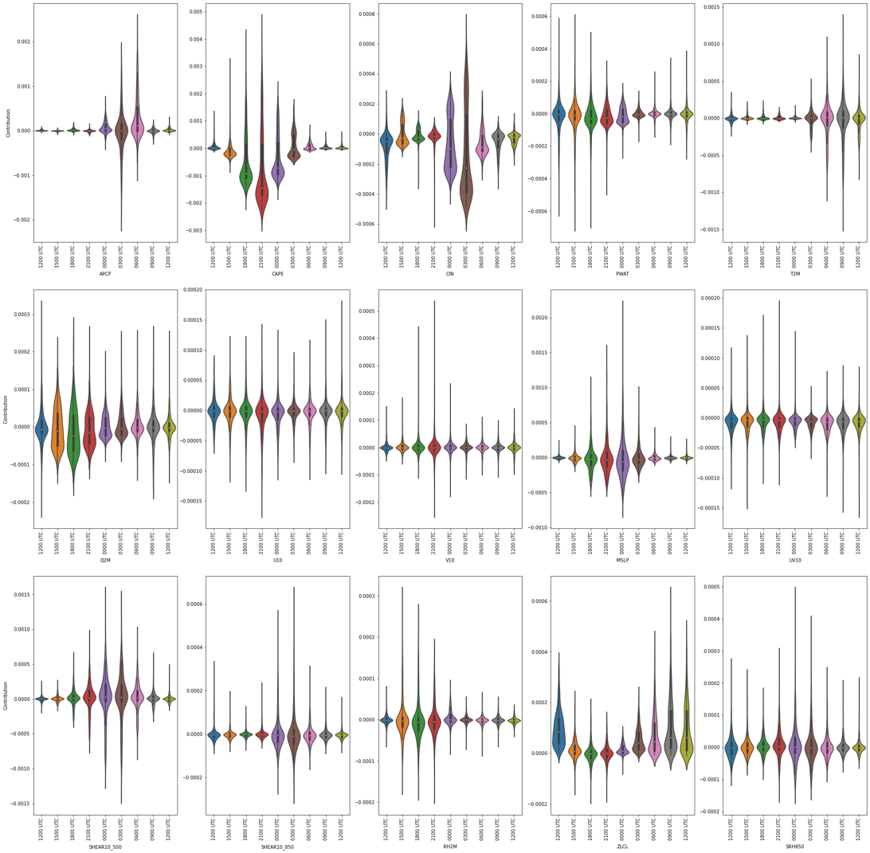
Interpretability/Explainability
CAPE
OK, the RFs learned important relationships in training…
What do they use on a day-to-day basis to make forecasts?
Probability = contribution₁ + contribution₂ + … + contribution_{n} + bias
Sum contribution of each meteorological variable/predictor across all forecasts
Day 1 hail forecast contributions
Break down by predictor hour
CIN
APCP
MSLP
500 Shear
Credit: Hanna McDaniel, CSU REU Student

Slide 35
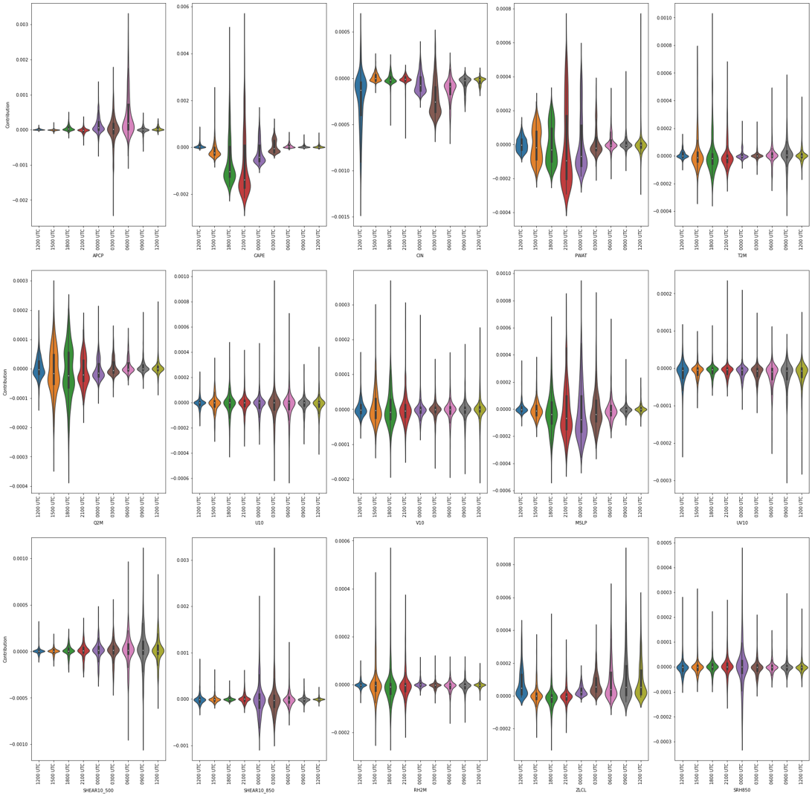
Interpretability/Explainability
OK, the RFs learned important relationships in training…
What do they use on a day-to-day basis to make forecasts?
Probability = contribution₁ + contribution₂ + … + contribution_{n} + bias
Sum contribution of each meteorological variable/predictor across all forecasts
Day 1 hail forecast contributions
Break down by predictor hour
CAPE Contributions to realtime day 1 hail forecasts
Credit: Hanna McDaniel, CSU REU Student

Slide 36
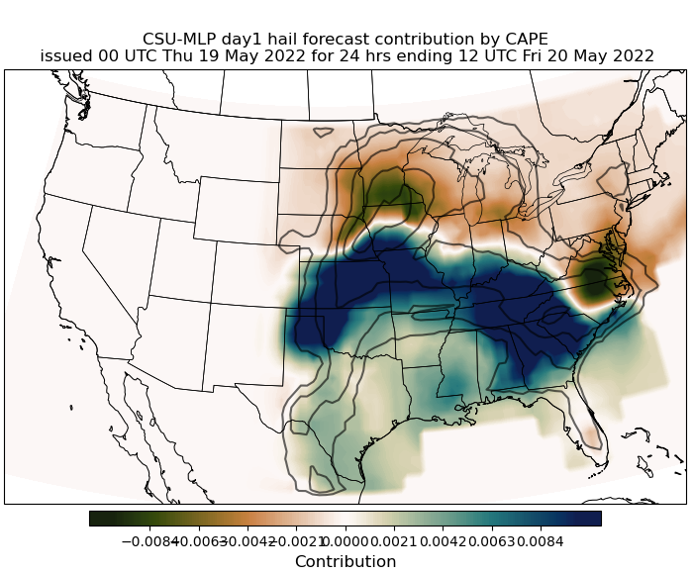
Interpretability/Explainability
OK, the RFs learned important relationships in training…
What do they use on a day-to-day basis to make forecasts?
Probability = contribution₁ + contribution₂ + … + contribution_{n} + bias
Sum contribution of each meteorological variable/predictor across all forecasts
Day 1 hail forecast contributions
Break down by predictor hour
CAPE 1500 UTC contribution to day 1 hail forecast
Credit: Hanna McDaniel, CSU REU Student

Slide 37
Summary and Next Steps
Day 1 forecasts compare similarly to SPC outlooks; skill gap (i.e., ML better) increases at day 2 and significantly at day 3
Reasonable RF-forecast skill and resolution out to day 6, likely a result of more frequent issuances of low-probability contours
CSU-MLP issues far more frequent probability contours; SPC is conservative when issuing outlooks, but tends to correctly forecast events when outlooks are issued
Interpretability metrics illustrate that the Random Forests are learning the relationships we know are important for severe weather forecasting
Constant feedback and discussion with SPC (and NWS orgs!!) to tailor products to their needs, e.g., day 9 and 10 forecasts, day 3 individual hazards
Contact: Aaron Hill (aaron.hill@colostate.edu)
Russ Schumacher (russ.schumacher@colostate.edu)

Slide 38
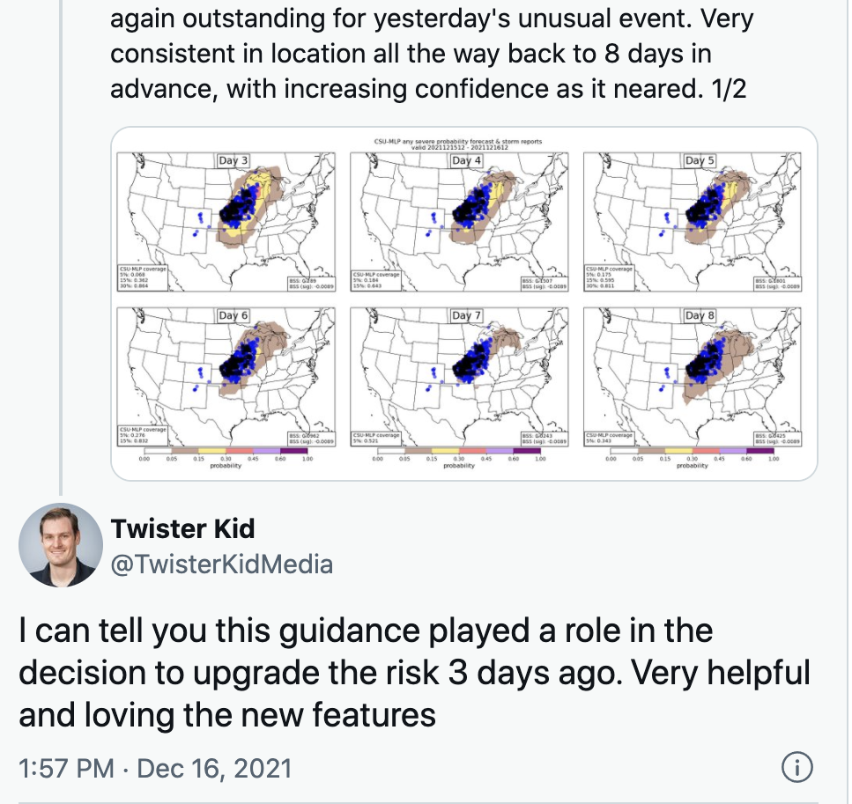
Summary and Next Steps
Day 1 forecasts compare similarly to SPC outlooks; skill gap (i.e., ML better) increases at day 2 and significantly at day 3
Reasonable RF-forecast skill and resolution out to day 6, likely a result of more frequent issuances of low-probability contours
CSU-MLP issues far more frequent probability contours; SPC is conservative when issuing outlooks, but tends to correctly forecast events when outlooks are issued
Interpretability metrics illustrate that the Random Forests are learning the relationships we know are important for severe weather forecasting
Constant feedback and discussion with SPC (and NWS offices!!) to tailor products to their needs, e.g., day 9 and 10 forecasts, day 3 individual hazards
Andrew Lyons, SPC Forecaster
Contact: Aaron Hill (aaron.hill@colostate.edu)
Russ Schumacher (russ.schumacher@colostate.edu)

Slide 39
Summary and Next Steps
Day 1 forecasts compare similarly to SPC outlooks; skill gap (i.e., ML better) increases at day 2 and significantly at day 3
Reasonable RF-forecast skill and resolution out to day 6, likely a result of more frequent issuances of low-probability contours
CSU-MLP issues far more frequent probability contours; SPC is conservative when issuing outlooks, but tends to correctly forecast events when outlooks are issued
Interpretability metrics illustrate that the Random Forests are learning the relationships we know are important for severe weather forecasting
Constant feedback and discussion with SPC (and NWS offices!!) to tailor products to their needs, e.g., day 9 and 10 forecasts, day 3 individual hazards
Contact: Aaron Hill (aaron.hill@colostate.edu)
Russ Schumacher (russ.schumacher@colostate.edu)

Slide 40
Real-time data
http://schumacher.atmos.colostate.edu/hilla/csu_mlp/index.php
Experimental forecasts galore
We have grib2 files!
Contact: Aaron Hill (aaron.hill@colostate.edu)
Russ Schumacher (russ.schumacher@colostate.edu)

